Slide 1
Physically-Based Simulation Milestone: Position Based Fluids
Group 17
Mengdi, Memedi, Danieletto

Slide 2
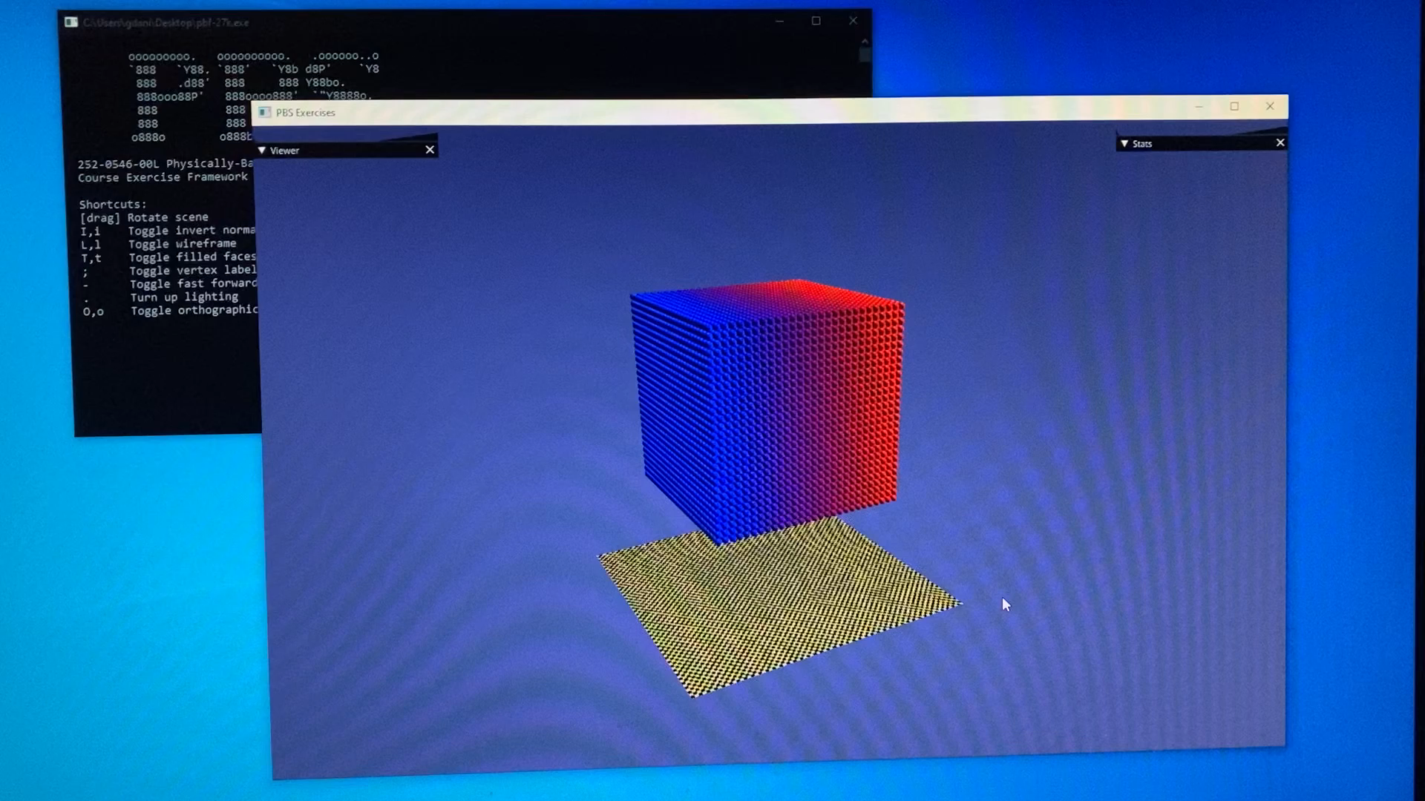
Demo
22K Particles – 25 fps

Slide 3
Current State
Update Loop
Working PBF-based
Parallelized (CPU)
Fast neighborhood search
Rendering
Instanced renderer on top of libigl renderer.

Slide 4
Current Issues
Particles sometimes escape boundary -> crash
Parameters do not seem correctly tuned

Slide 5
Remaining Tasks
Fix parameters
Fix boundary handling
Add interaction possibility (moving boundary)
Improve Rendering
Port to GPU

Slide 6

Timeline
Constraint Solver
15/11
Simulation steps
24/11
Improved Shading
15/12
Scenes
03/11
( )
Optimizations / GPU port
10/12

